Slide 1
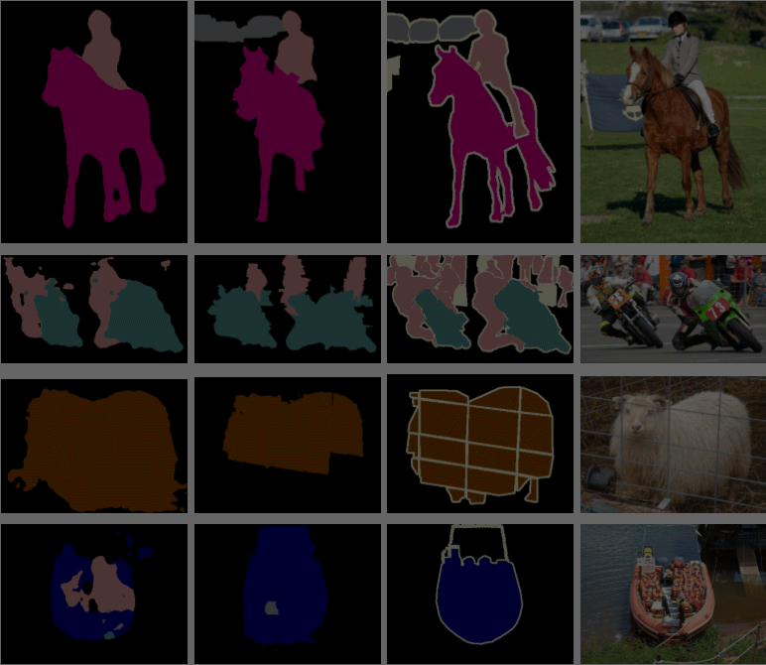
Fully Convolutional Networks for Semantic Segmentation
Jonathan Long, Evan Shelhamer, and Trevor Darrell

Slide 2
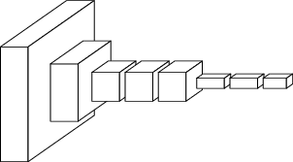
What is segmentation?
Classify each pixel independently
???
Images from Shelhamer, Long and Darrell

Slide 3
Why segmentation?
Also solves classification problems.
Solves localization aspects of object detection, but doesn’t differentiate well between same-class objects
3D reconstruction
Segmentation provides contour information
Medical imaging
Identify tumours
Measure abnormalities
Surgery planning / assistance
Diagnostics

Slide 4
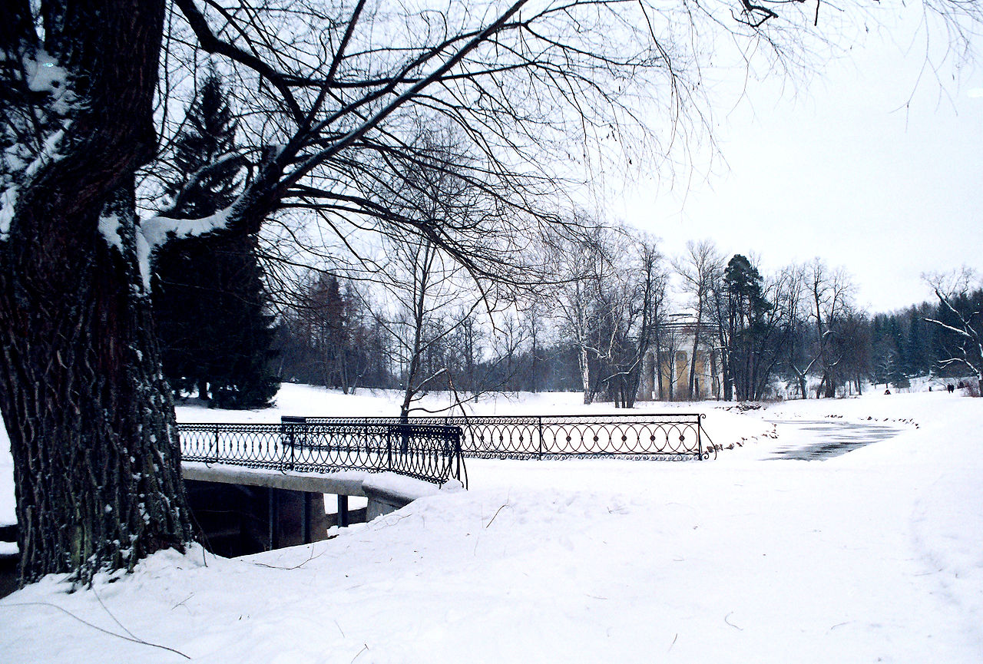
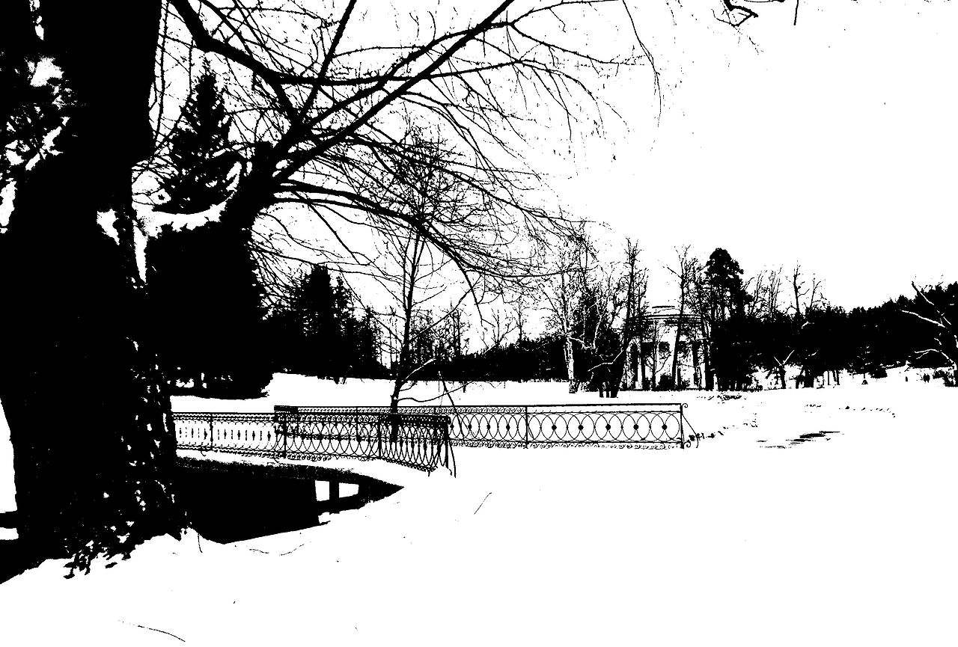
How? - A brief history
Thresholding
Convert to grayscale and apply a threshold for binary segmentation (is object / is background)

Slide 5
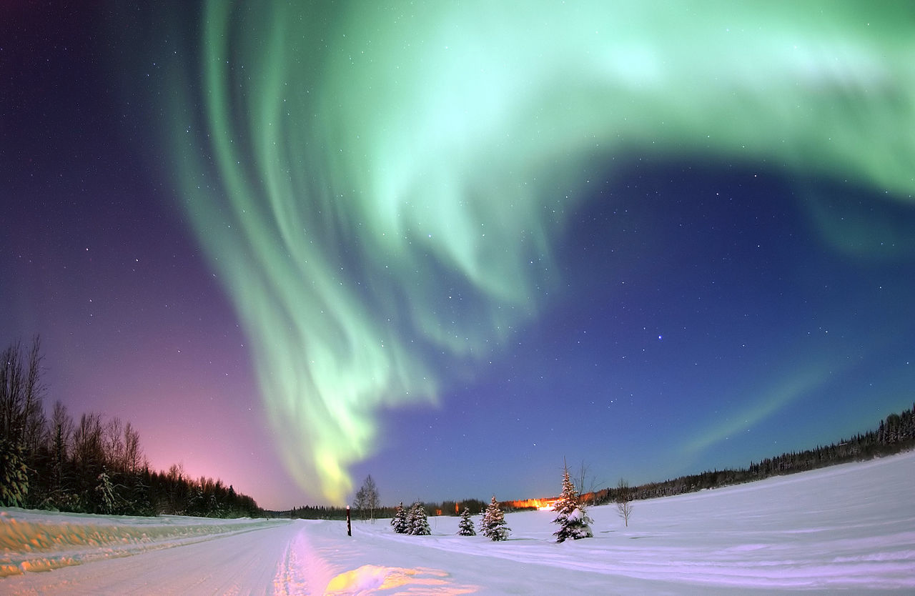
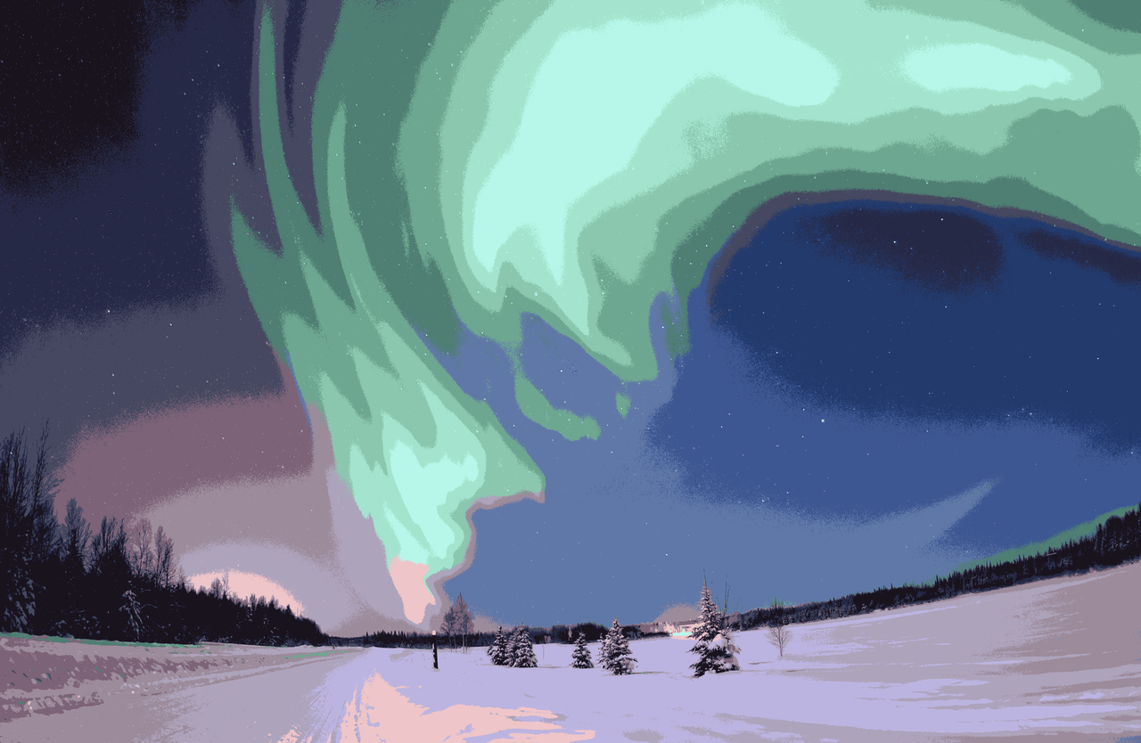
How? - A brief history
Clustering
Cluster pixels based on color, intensity, location, etc.

Slide 6
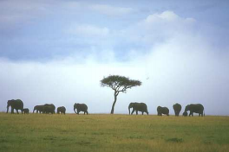
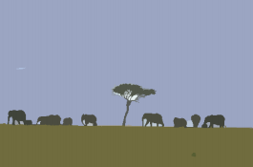
How? - A brief history
Histogram
Split histogram around peaks / valleys and partition pixels accordingly
http://marjan.fesb.hr/~dkrst/fhs/data/fhs-postprint.pdf

Slide 7
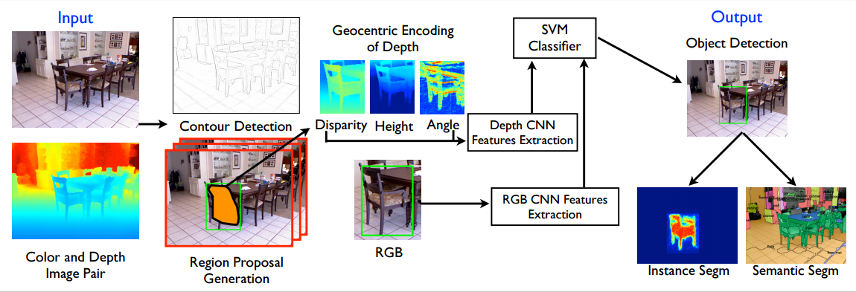
What about deep learning? - Previous state of the art
Based on R-CNN, Gupta et al. add depth to the model and do pixel classification via random forest
https://people.eecs.berkeley.edu/~sgupta/pdf/rcnn-depth.pdf

Slide 8
Roadmap to understanding FCN semantic segmentation
Becoming size agnostic - Fully Connected Nets to Fully Convolutional Networks
What the heck is a “Deconvolution”
Putting it all together - Network Architectures
Demo Time!

Slide 9
FCN - What is it?
“In Convolutional Nets, there is no such thing as "fully-connected layers". There are only convolutional layers with 1x1 convolution kernels and a full connection table.”
Yann Lecun
Think of fully connected layers as convolutions
We will see how this helps later…
w1,1 | w1,2 | w1,3
w2,1 | w2,2 | w2,3
w3,1 | w3,2 | w3,3
x
a | b | c
w1,1 | w2,1 | w3,1
a | b | c
x
=
x
a | b | c
w1,2 | w2,2 | w3,2
x
a | b | c
w1,3 | w2,3 | w3,3
Notes:
We can think of fully connected layers as a series of convolutions

Slide 10
What is a deconvolution? - How not to think about it...
“Upsampling is (fractionally strided) convolution”
Bilinear Interpolation
Googling deconvolve
Stack overflow
“Reversing forward and backward passes of more typical strided convolution”

Slide 11
What is a deconvolution? - Forward pass
Output:
Input:
5 | 7
4 | 3
W
b
1 | 3 | 2 | 7
3 | 0 | 8 | 2
4 | 3 | 7 | 2
8 | 10 | 3 | 7
0 | 1 | -2 | 3
7 | 2 | 5 | 7
4 | 1 | 0 | 3
0 | 7 | 0 | 2

Slide 12
What is a deconvolution? - Forward pass
Output:
5 * 1 + 0 | 5 * 3 + 1 | 5 * 2 - 2 | 5 * 7 + 3
5 * 3 + 7 | 5 * 0 - 2 | 5 * 8 + 5 | 5 * 2 - 7
5 * 4 + 4 | 5 * 3 + 1 | 5 * 7 + 0 | 5 * 2 + 3
5 * 8 + 0 | 5 * 10 + 7 | 5 * 3 + 0 | 5 * 7 + 2
Input:
5 | 7
4 | 3
W
b
1 | 3 | 2 | 7
3 | 0 | 8 | 2
4 | 3 | 7 | 2
8 | 10 | 3 | 7
0 | 1 | -2 | 3
7 | 2 | 5 | 7
4 | 1 | 0 | 3
0 | 7 | 0 | 2

Slide 13
What is a deconvolution? - Forward pass
Output:
 |  | 7 * 1 + 0 | 7 * 3 + 1 | 7 * 2 - 2 | 7 * 7 + 3
 |  | 7 * 3 + 7 | 7 * 0 - 2 | 7 * 8 + 5 | 7 * 2 - 7
 |  | 7 * 4 + 4 | 7 * 3 + 1 | 7 * 7 + 0 | 7 * 2 + 3
 |  | 7 * 8 + 0 | 7 * 10 + 7 | 7 * 3 + 0 | 7 * 7 + 2
Input:
5 | 7
4 | 3
W
b
1 | 3 | 2 | 7
3 | 0 | 8 | 2
4 | 3 | 7 | 2
8 | 10 | 3 | 7
0 | 1 | -2 | 3
7 | 2 | 5 | 7
4 | 1 | 0 | 3
0 | 7 | 0 | 2

Slide 14
What is a deconvolution? - Forward pass
Output:
4 * 1 + 0 | 4 * 3 + 1 | 4 * 2 - 2 | 4 * 7 + 3
4 * 3 + 7 | 4 * 0 - 2 | 4 * 8 + 5 | 4 * 2 - 7
4 * 4 + 4 | 4 * 3 + 1 | 4 * 7 + 0 | 4 * 2 + 3
4 * 8 + 0 | 4 * 10 + 7 | 4 * 3 + 0 | 4 * 7 + 2
Input:
5 | 7
4 | 3
W
b
1 | 3 | 2 | 7
3 | 0 | 8 | 2
4 | 3 | 7 | 2
8 | 10 | 3 | 7
0 | 1 | -2 | 3
7 | 2 | 5 | 7
4 | 1 | 0 | 3
0 | 7 | 0 | 2

Slide 15
What is a deconvolution? - Forward pass
Output:
 |  | 3 * 1 + 0 | 3 * 3 + 1 | 3 * 2 - 2 | 3 * 7 + 3
 |  | 3 * 3 + 7 | 3 * 0 - 2 | 3 * 8 + 5 | 3 * 2 - 7
 |  | 3 * 4 + 4 | 3 * 3 + 1 | 3 * 7 + 0 | 3 * 2 + 3
 |  | 3 * 8 + 0 | 3 * 10 + 7 | 3 * 3 + 0 | 3 * 7 + 2
Input:
5 | 7
4 | 3
W
b
1 | 3 | 2 | 7
3 | 0 | 8 | 2
4 | 3 | 7 | 2
8 | 10 | 3 | 7
0 | 1 | -2 | 3
7 | 2 | 5 | 7
4 | 1 | 0 | 3
0 | 7 | 0 | 2

Slide 16
What is a deconvolution? - Forward Pass Implementation
“Reversing forward and backward passes of more typical strided convolution”

Slide 17
What is a deconvolution? - Caffe implementation

Slide 18
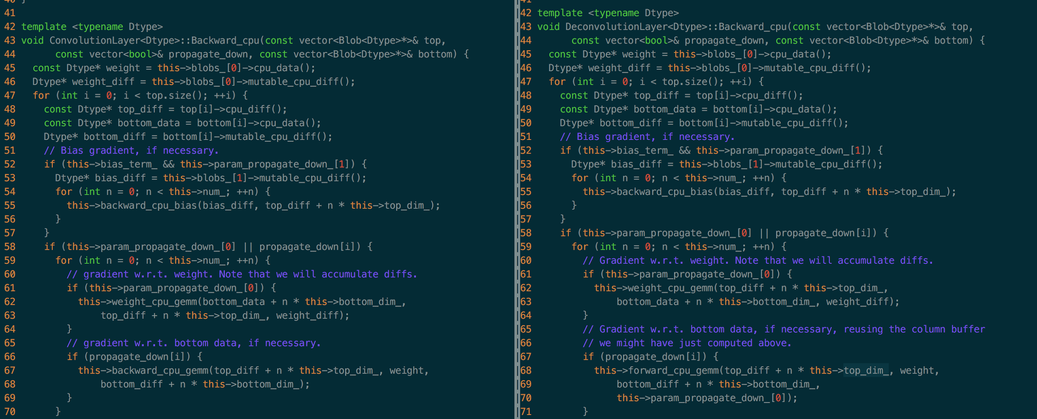
What is a deconvolution? - Caffe implementation

Slide 19
Convolutional Layer backward pass
backward_cpu_gemm(top_diff + n * this->top_dim_, weight,
bottom_diff + n * this->bottom_dim_);
Downstream Derivative (C++ pointer idiom)
Convolution weight
dx (C++ pointer idiom)

Slide 20
Convolutional Layer backward pass
backward_cpu_gemm(top_diff + n * this->top_dim_, weight,
bottom_diff + n * this->bottom_dim_);
Downstream Derivative (C++ pointer idiom)
Convolution weight
dx (C++ pointer idiom)

Slide 21
Convolutional Layer backward pass
backward_cpu_gemm(top_diff + n * this->top_dim_, weight,
bottom_diff + n * this->bottom_dim_);
Downstream Derivative (C++ pointer idiom)
Convolution weight
dx (C++ pointer idiom)

Slide 22
Convolution Backward --> Deconvolution Forward
backward_cpu_gemm(top_diff + n * this->top_dim_, weight,
bottom_diff + n * this->bottom_dim_);
backward_cpu_gemm(bottom_data + n * this->bottom_dim_, weight,
top_data + n * this->top_dim_);
Downstream Derivative --> Upstream Data
Convolution weights --> Deconvolution weights
dx --> Output

Slide 23
Convolution Backward --> Deconvolution Forward
backward_cpu_gemm(top_diff + n * this->top_dim_, weight,
bottom_diff + n * this->bottom_dim_);
backward_cpu_gemm(bottom_data + n * this->bottom_dim_, weight,
top_data + n * this->top_dim_);
Downstream Derivative --> Upstream Data
Convolution weights --> Deconvolution weights
dx --> Output

Slide 24
Convolution Backward --> Deconvolution Forward
backward_cpu_gemm(top_diff + n * this->top_dim_, weight,
bottom_diff + n * this->bottom_dim_);
backward_cpu_gemm(bottom_data + n * this->bottom_dim_, weight,
top_data + n * this->top_dim_);
Downstream Derivative --> Upstream Data
Convolution weights --> Deconvolution weights
dx --> Output

Slide 25
Convolutional Layer forward pass
forward_cpu_gemm(bottom_data + n * this->bottom_dim_, weight, top_data + n * this->top_dim_);
X - Upstream data (C++ pointer idiom)
W - Convolution weights
Y - Output (C++ pointer idiom)

Slide 26
Convolutional Layer forward pass
forward_cpu_gemm(bottom_data + n * this->bottom_dim_, weight, top_data + n * this->top_dim_);
X - Upstream data (C++ pointer idiom)
W - Convolution weights
Y - Output (C++ pointer idiom)

Slide 27
Convolutional Layer forward pass
forward_cpu_gemm(bottom_data + n * this->bottom_dim_, weight, top_data + n * this->top_dim_);
X - Upstream data (C++ pointer idiom)
W - Convolution weights
Y - Output (C++ pointer idiom)

Slide 28
Convolution forward --> Deconvolution backward
forward_cpu_gemm(bottom_data + n * this->bottom_dim_, weight, top_data + n * this->top_dim_);
forward_cpu_gemm(top_diff + n * this->top_dim_, weight, bottom_diff + n * this->bottom_dim_,
this->param_propagate_down_[0]);
Upstream data --> Downstream derivative
Convolution weights --> Deconvolutional weights
Output --> dx

Slide 29
Convolution forward --> Deconvolution backward
forward_cpu_gemm(bottom_data + n * this->bottom_dim_, weight, top_data + n * this->top_dim_);
forward_cpu_gemm(top_diff + n * this->top_dim_, weight, bottom_diff + n * this->bottom_dim_,
this->param_propagate_down_[0]);
Upstream data --> Downstream derivative
Convolution weights --> Deconvolutional weights
Output --> dx

Slide 30
Convolution forward --> Deconvolution backward
forward_cpu_gemm(bottom_data + n * this->bottom_dim_, weight, top_data + n * this->top_dim_);
forward_cpu_gemm(top_diff + n * this->top_dim_, weight, bottom_diff + n * this->bottom_dim_,
this->param_propagate_down_[0]);
Upstream data --> Downstream derivative
Convolution weights --> Deconvolutional weights
Output --> dx

Slide 31
What about dw?
weight_cpu_gemm(bottom_data + n * this->bottom_dim_,top_diff + n * this->top_dim_, weight_diff);
weight_cpu_gemm(top_diff + n * this->top_dim_,bottom_data + n * this->bottom_dim_, weight_diff);
Cached Upstream Receptive Fields --> Downstream derivative
Downstream derivatives --> Cached Upstream Receptive Fields
dw --> dw

Slide 32
What about dw?
weight_cpu_gemm(bottom_data + n * this->bottom_dim_,top_diff + n * this->top_dim_, weight_diff);
weight_cpu_gemm(top_diff + n * this->top_dim_,bottom_data + n * this->bottom_dim_, weight_diff);
Cached Upstream Receptive Fields --> Downstream derivative
Downstream derivatives --> Cached Upstream Receptive Fields
dw --> dw

Slide 33
What about dw?
weight_cpu_gemm(bottom_data + n * this->bottom_dim_,top_diff + n * this->top_dim_, weight_diff);
weight_cpu_gemm(top_diff + n * this->top_dim_,bottom_data + n * this->bottom_dim_, weight_diff);
Cached Upstream Receptive Fields --> Downstream derivative
Downstream derivatives --> Cached Upstream Receptive Fields
dw --> dw
Notes:
dW is obtained by summing the product each of the cached receptive field with upstream derivatives.

Slide 34
Putting it together - Fully Convolutional Network
Take classification networks that perform well
VGG, AlexNet, GoogLeNet (We end up using VGG16)
Remove final classification layer
Cast fully connected layers to convolutions

Slide 35
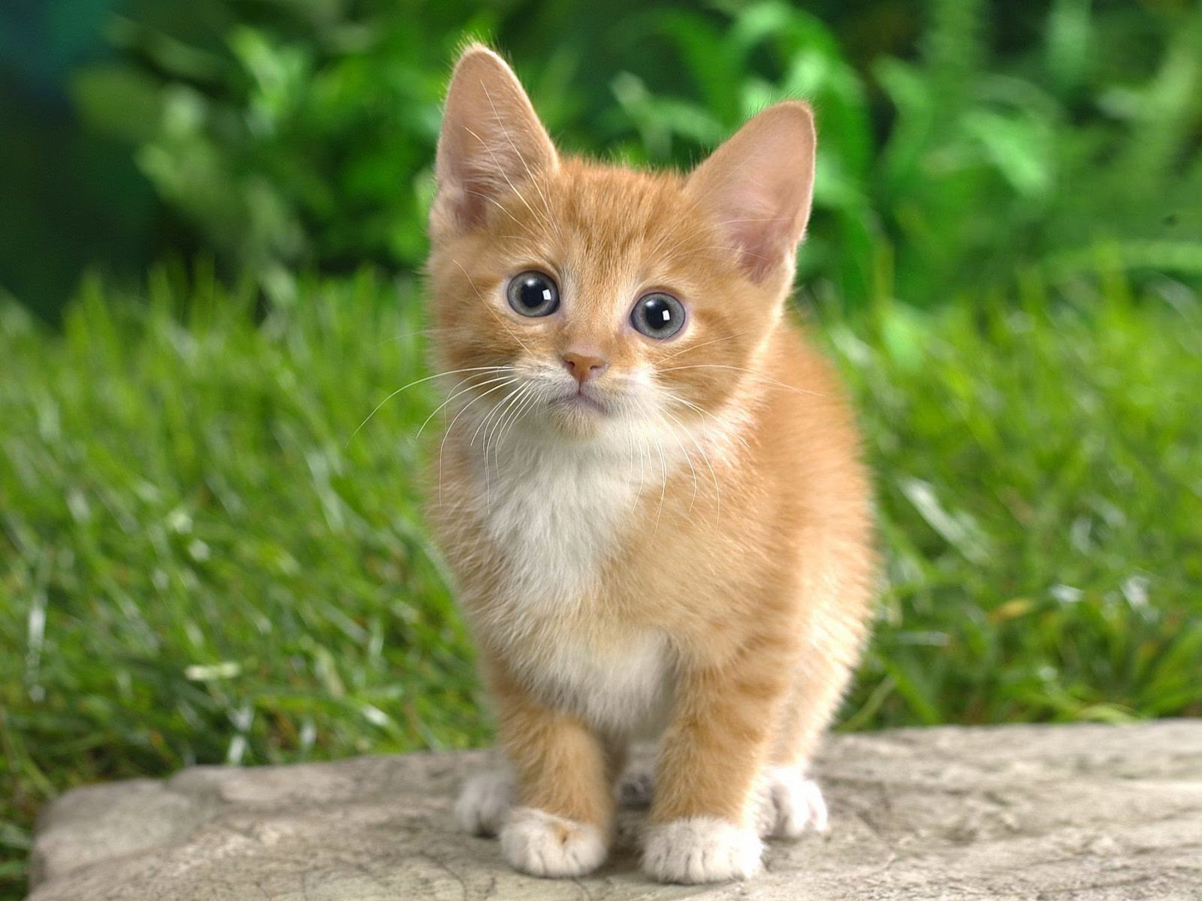
Putting it together - Fully Convolutional Network
Classification Network
Convolutional
Layers
Fully-Connected
Layers
Scores
(fixed size)

Slide 36
Putting it together - Fully Convolutional Network
Fully Convolutional Network
Convolutional
Layers
NxM
Convolutional
Layer
NxMxL
Scores
(size ~ image size)
1x1
Convolutions

Slide 37
Putting it together - Fully Convolutional Network
Upsample using deconvolutions
Now that the FC layers are convolutional, we can handle arbitrary image dimensions
Convolutional
Layers
NxM
Convolutional
Layer
NxMxL
Deconvolutional
Layers
Pixelwise
Prediction
Pixelwise
Scores
Deconvolutional
Layer
1x1
Convolutions

Slide 38
Putting it together - Fully Convolutional Network
Now we have a dense prediction, but it could still be better
We lose spatial information when we go down to the “fully connected” parts
Fix this by adding skip layers and fusion layers

Slide 39
Putting it together - Fully Convolutional Network
Skip layers
Take early layers which encode spatial information and send their output further ahead in the network, forming a DAG
Layer 1
NxMxL
Layer 2
...
Layer N
(deconv)
NxMxL
Layer N+1
(fusion)
Skip

Slide 40
Putting it together - Fully Convolutional Network
Fusion layers
Take multiple layers with the same dimensionality as input
Sum the inputs elementwise
Layer 1
NxMxL
Fusion Layer
Elementwise
Layer 1 + Layer 2
NxMxL
NxMxL
Layer 2

Slide 41
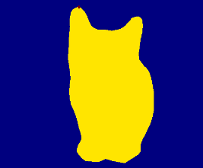
Putting it together - Fully Convolutional Network
Combine the dense representations from early in the network with the upsampled sparse representations from deeper in the network to get accurate pixelwise predictions
Conv
NxMxL
NxM Conv
Deconvolutional
Layers
Conv/Decov (rescale)
Fuse
Deconv
1x1 Conv
Pixelwise Scores

Slide 42
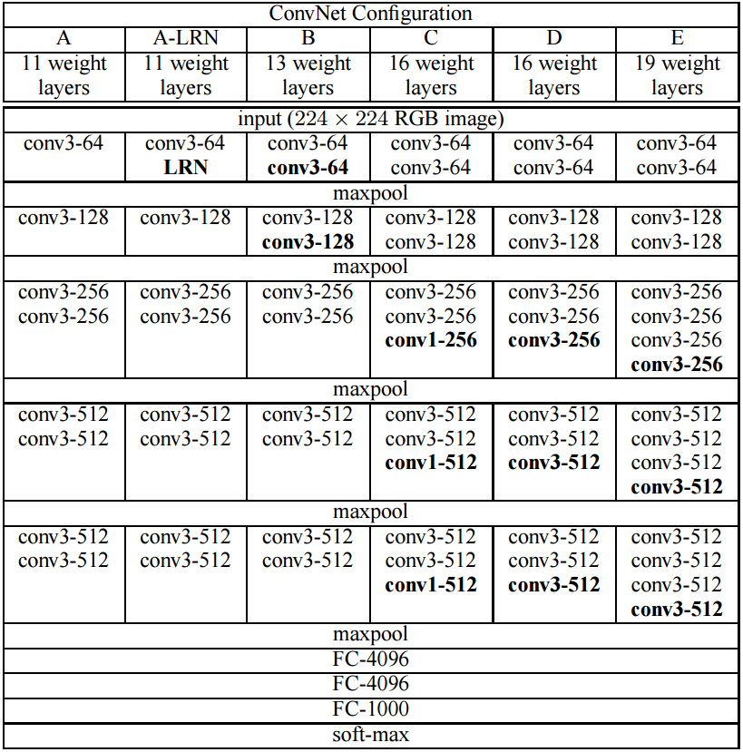
Putting it together - Fully Convolutional Network
VGG Base Model (FCN uses configuration D)
Conv layers
stride 1
RELU
Maxpool layers
Kernel size 2
Stride 2
FC layers
Dropout .5
RELU
< cast to 7x7 convolutions
< cast to 1x1 convolutions
< replace with 21 1x1 convolutions

Slide 43
Putting it together - Fully Convolutional Network
Input (arbitrary size)
conv3-64
conv3-64
maxpool 1
conv3-128
conv3-128
maxpool 2
conv3-256
conv3-256
conv3-256
maxpool 3
conv3-512
conv3-512
conv3-512
maxpool 4
conv3-512
conv3-512
conv3-512
maxpool 5
conv7-4096
conv1-4096
conv1-21
deconv64-21 stride 32
crop to data size
softmax
FCN-32s
Pad input by 100
Cast FC layers to conv
Upscale with deconv
Still use dropout on “FC” layers

Slide 44
Input (arbitrary size)
conv3-64
conv3-64
maxpool 1
conv3-128
conv3-128
maxpool 2
conv3-256
conv3-256
conv3-256
maxpool 3
conv3-512
conv3-512
conv3-512
maxpool 4
conv3-512
conv3-512
conv3-512
maxpool 5
conv7-4096
conv1-4096 | conv1-21
conv1-21 | crop
deconv4-21 stride 2 | fuse | upscore32-21 stride 16 | crop to data size | softmax
FCN-16s

Slide 45
Input (arbitrary size)
conv3-64
conv3-64
maxpool 1
conv3-128
conv3-128
maxpool 2
conv3-256
conv3-256
conv3-256
maxpool 3
conv3-512
conv3-512
conv3-512
maxpool 4
conv3-512
conv3-512
conv3-512
maxpool 5
conv7-4096
conv1-4096 | conv1-21 |  | conv1-21
conv1-21 | crop |  | crop
deconv4-21 stride 2 | fuse | upscore4-21 stride 2 | fuse | upscore16-21 stride 8 | deconv16-21 stride 8 | crop | softmax
FCN-8s

Slide 46
Putting it together - Fully Convolutional Network
Staged versus Unstaged Training
Unstaged
Train FCN-16s and FCN-8s from the VGG16 weights directly
Staged
Train FCN-32s from VGG16 weights
Add skip / fusion from pool layer 4 and fine-tune FCN-16s from the FCN-32s weights
Add skip / fusion from pool layer 3 and fine-tune FCN-8s from the FCN-16s weights
Unstaged training is much faster to train just FCN-8s than staged training

Slide 47
Segmentation Evaluation
Pixel accuracy
Accuracy on a per pixel basis
Mean accuracy
Mean pixelwise accuracy over all classes
Avoid seemingly good results due to lots of background classification
Mean IU
Mean intersection over union over all classes
Frequency Weighted IU
Mean intersection over union over all classes, weighted by total number of pixels belonging to that class
Image from Shelhamer, Long and Darrell

Slide 48
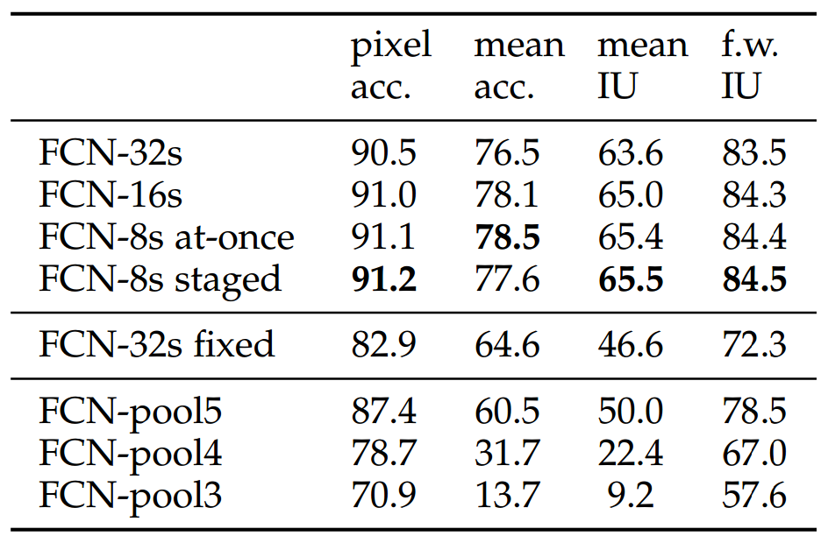
Segmentation Evaluation
Image from Shelhamer, Long and Darrell

Slide 49
DEMO TIME!

Slide 50
Question Time...

